Slide 1
Analytical Methods for Business
Dr. Ronald K. Satterfield
Muma College of Business
University of South Florida

Slide 2
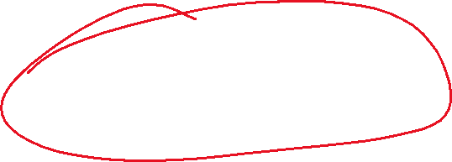
Module 2 Probability Distributions & CLT
Dr. Ronald K. Satterfield
Muma College of Business
University of South Florida
The “Shape” of Data

Slide 3

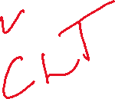

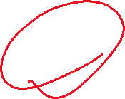

Plan for This Presentation
Probability Distributions in General
Fundamental Types of Distributions
Normal Distributions
Areas Under the Normal Curve
Sampling Distributions
Lecture Plan | Statistical Distributions | Normal Distributions | Areas Under a Normal Curve
Assessing Normality | Sampling Distributions |  | Conclusion

Slide 4
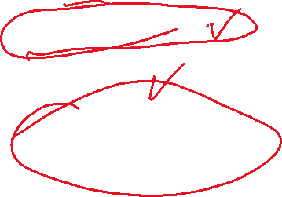
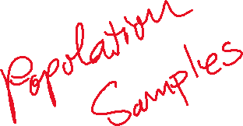
What Is a Statistical Distribution?
Graphical Representation
“Shape” of a Distribution
Peaks and Tails
Skewness
Types of Distributions
Lecture Plan | Statistical Distributions | Normal Distributions | Areas Under a Normal Curve
Assessing Normality | Sampling Distributions |  | Conclusion

Slide 5
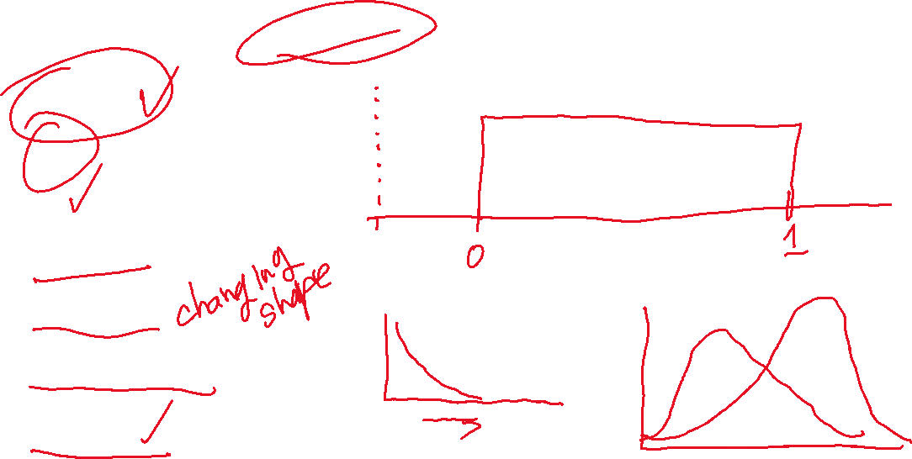
Common Types of Distributions
Normal
t
F
Uniform
Poisson
Exponential
Weibull
Lecture Plan | Statistical Distributions | Normal Distributions | Areas Under a Normal Curve
Assessing Normality | Sampling Distributions |  | Conclusion

Slide 6
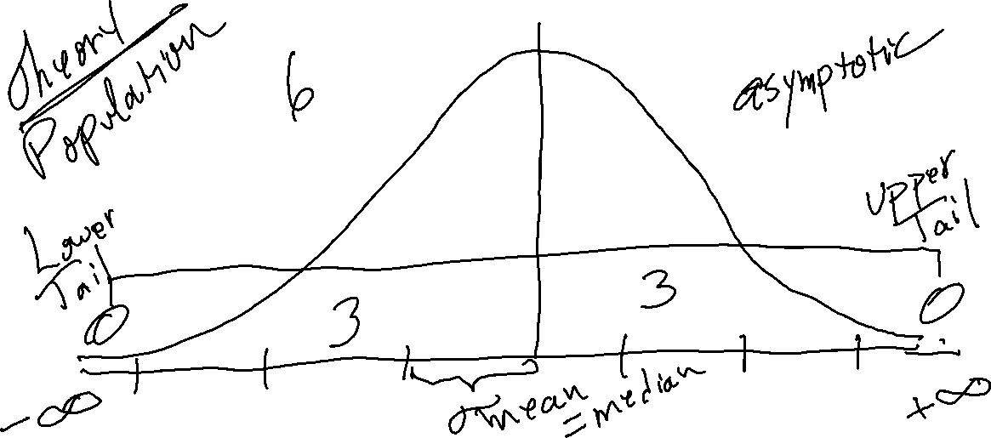
The Normal Distribution
Lecture Plan | Statistical Distributions | Normal Distributions | Areas Under a Normal Curve
Assessing Normality | Sampling Distributions |  | Conclusion

Slide 7
The Normal Probability Density Function
Lecture Plan | Statistical Distributions | Normal Distributions | Areas Under a Normal Curve
Assessing Normality | Sampling Distributions |  | Conclusion

Slide 8


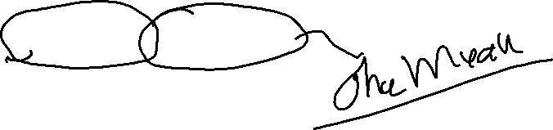
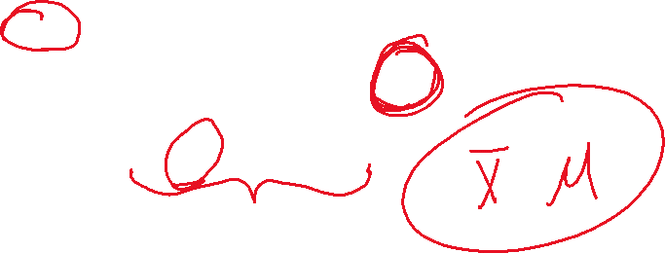
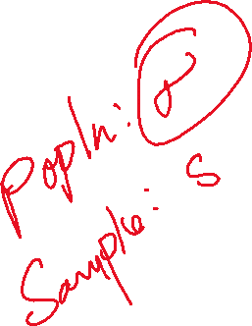
The Standard Deviation
Lecture Plan | Statistical Distributions | Normal Distributions | Areas Under a Normal Curve
Assessing Normality | Sampling Distributions |  | Conclusion

Slide 9

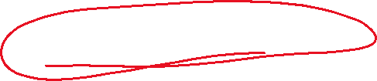
The Empirical Rule
68% within 1 standard deviation
95% within 2 standard deviations
99.7% within 3 standard deviations
Lecture Plan | Statistical Distributions | Normal Distributions | Areas Under a Normal Curve
Assessing Normality | Sampling Distributions |  | Conclusion

Slide 10


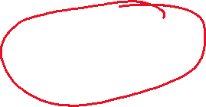

Putting the Normal Distribution to Work Areas Under the Normal Curve
Mean = 72
Standard Deviation = 14
This Year's Sales = 1,000,000 units
Warranty Replacement Cost = $200
Lecture Plan | Statistical Distributions | Normal Distributions | Areas Under a Normal Curve
Assessing Normality | Sampling Distributions |  | Conclusion

Slide 11


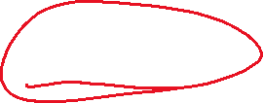
Assessing Normality
Histograms
Q-Q Plots
Other Tools We’ll Discuss Later
Lecture Plan | Statistical Distributions | Normal Distributions | Areas Under a Normal Curve
Assessing Normality | Sampling Distributions |  | Conclusion

Slide 12
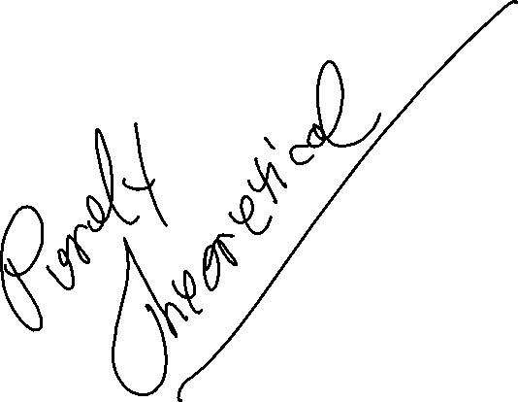
Sampling Distributions The Central Limit Theorem
Dr. Ronald K. Satterfield
Muma College of Business
University of South Florida

Slide 13
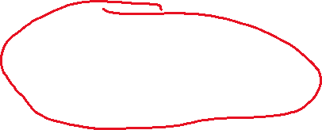
Sampling Distributions A Detour into Theory
Central Limit Theorem
Sampling Distributions
Basic Theoretical Concepts
Excel Demonstration
Lecture Plan | Statistical Distributions | Normal Distributions | Areas Under a Normal Curve
Assessing Normality | Sampling Distributions |  | Conclusion

Slide 14

Sampling Distributions The Central Limit Theorem
As the sample size (the number of values in each sample) gets large enough, the sampling distribution of the mean is approximately normally distributed. This is true regardless of the shape of the distribution of the individual values in the population.
Lecture Plan | Statistical Distributions | Normal Distributions | Areas Under a Normal Curve
Assessing Normality | Sampling Distributions |  | Conclusion

Slide 15

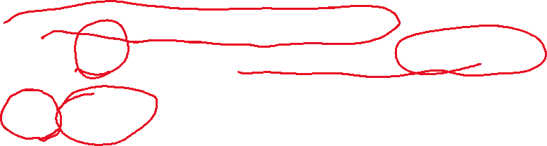
Sampling Distributions The Central Limit Theorem
Consider a random sample of n observations selected from a population (any population) with mean and standard deviation . Then, when n is sufficiently large, the sampling distribution of will be approximately a normal distribution with mean and
standard deviation . The larger the sample size the better will be the normal approximation to the sampling distribution of .
Lecture Plan | Statistical Distributions | Normal Distributions | Areas Under a Normal Curve
Assessing Normality | Sampling Distributions |  | Conclusion

Slide 16
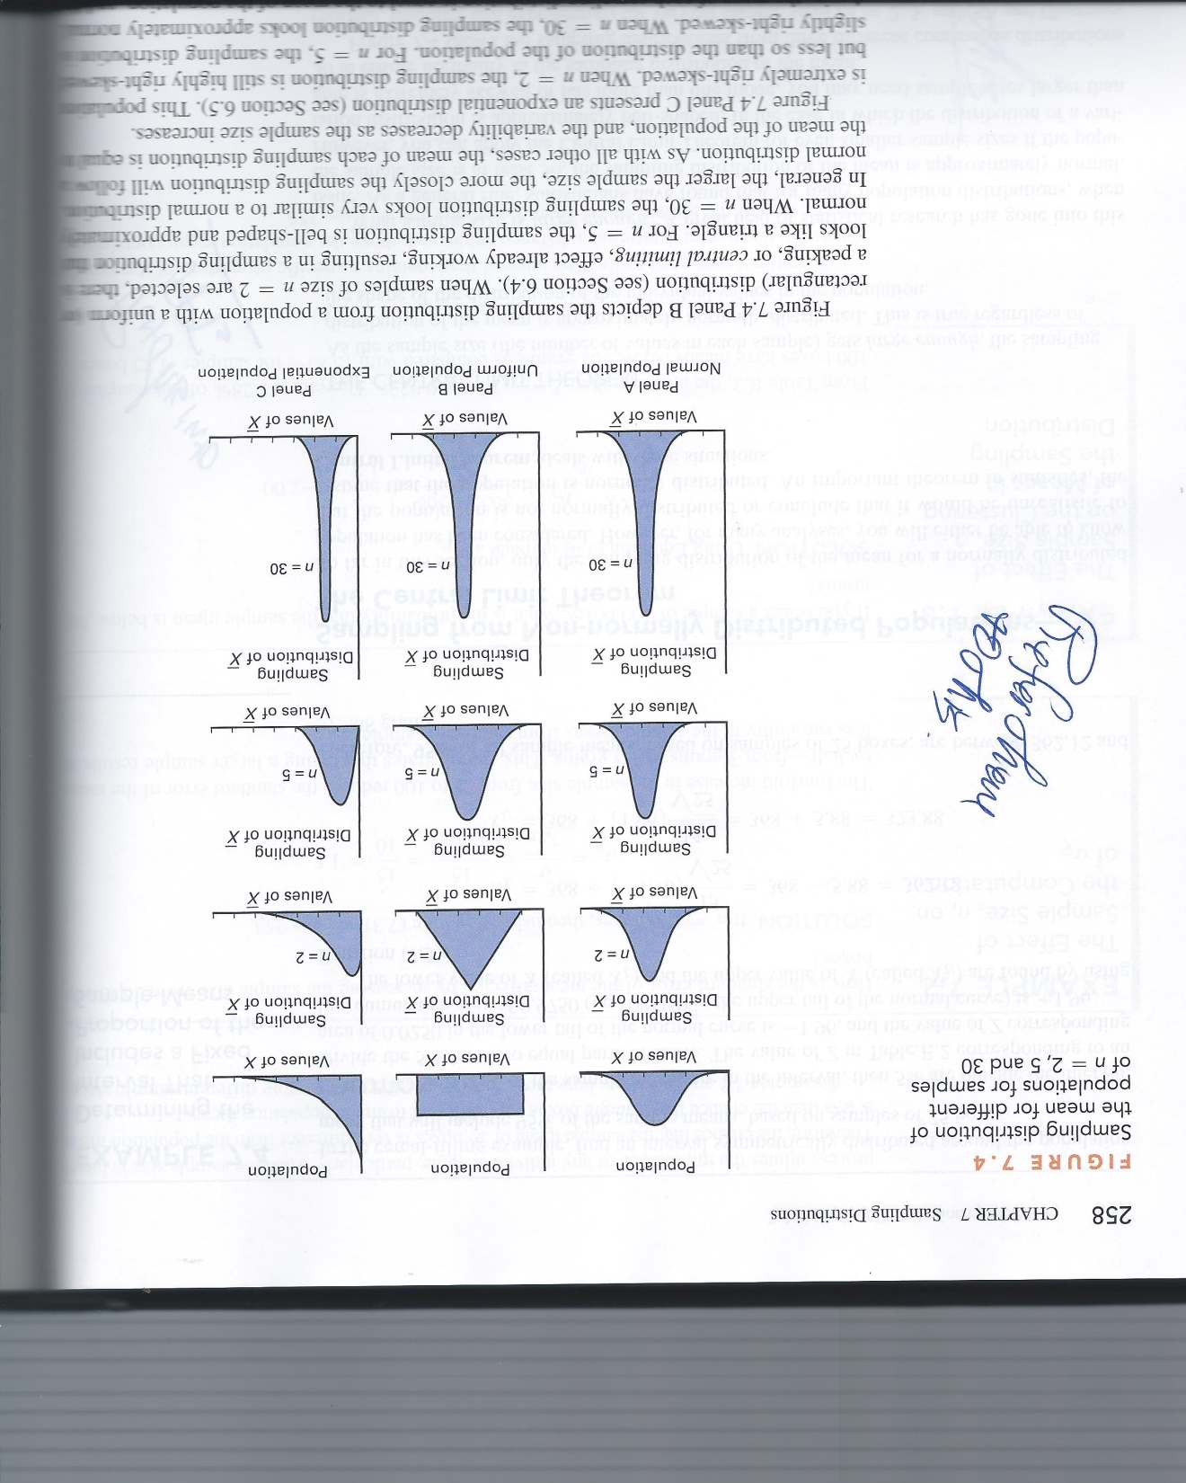
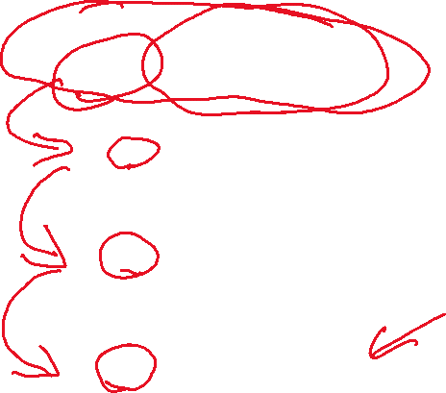
Sampling Distributions A Detour into Theory
Lecture Plan | Statistical Distributions | Normal Distributions | Areas Under a Normal Curve
Assessing Normality | Sampling Distributions |  | Conclusion

Slide 17
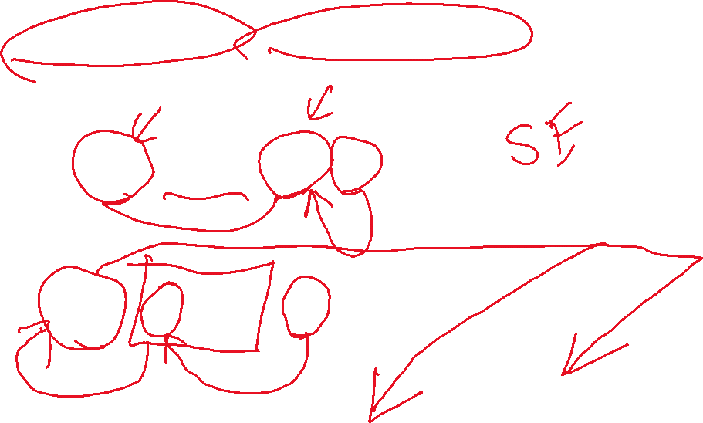
Sampling Distributions Estimating Mean & Standard Deviation
Also Called “Standard Error”
Also Called “Standard Error of the Mean”
Lecture Plan | Statistical Distributions | Normal Distributions | Areas Under a Normal Curve
Assessing Normality | Sampling Distributions |  | Conclusion

Slide 18
Demonstration in Excel
Lecture Plan | Statistical Distributions | Normal Distributions | Areas Under a Normal Curve
Assessing Normality | Sampling Distributions |  | Conclusion

Slide 19
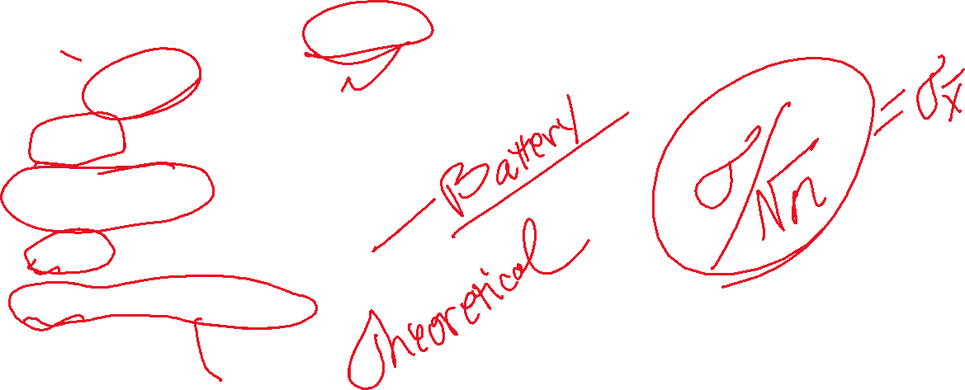
What Have We Covered?
Statistical Distributions in General
Some Types of Distributions
Normal Distributions in Particular
Empirical Rule
Areas Under the Normal Curve
Sampling Distributions
Lecture Plan | Statistical Distributions | Normal Distributions | Areas Under a Normal Curve
Assessing Normality | Sampling Distributions |  | Conclusion

